Slide 1

Student grade book
Presentation Based on synobsis

Slide 2
Topics covered
Introduction
Objectives
Scope
Problems
Requirements
Hardware
Software
Design
Flowchart

Slide 3
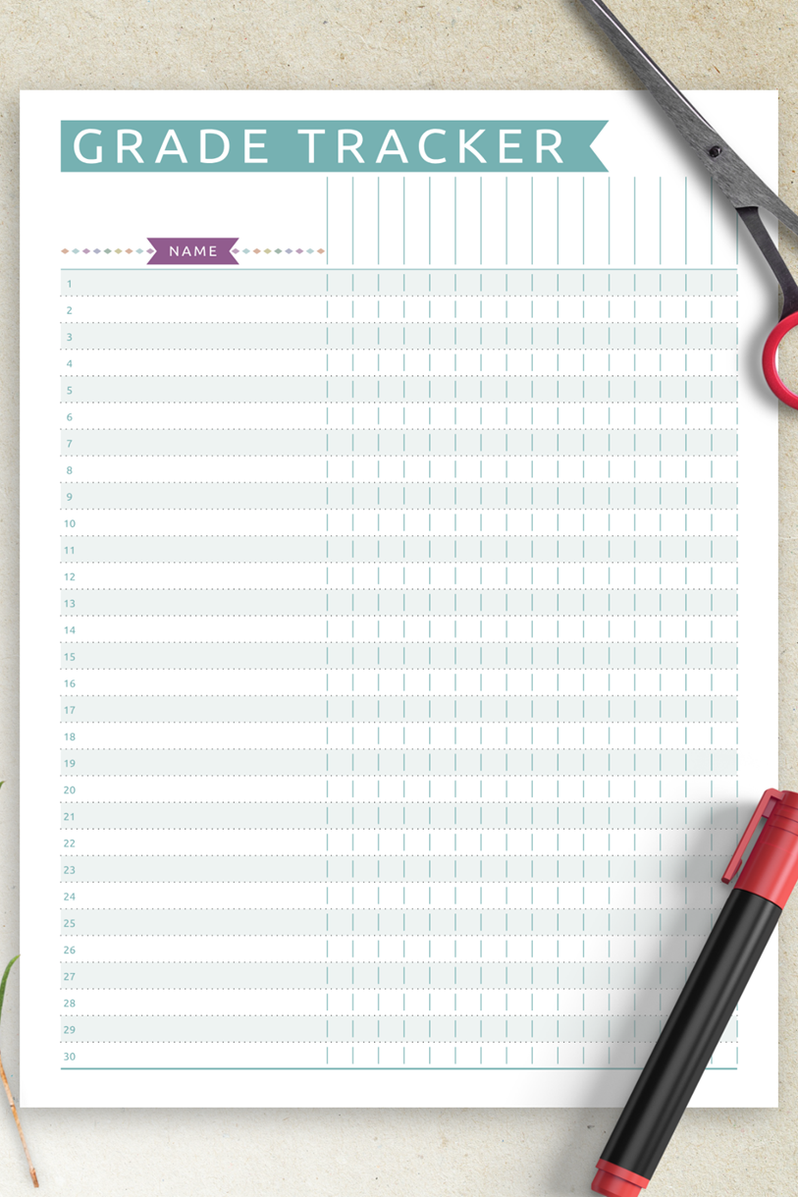
introduction
The creative and useful Student Grade Book Mini Project in C aims to improve and modernize the administration of student grades in educational institutions. This project offers a technologically cutting-edge solution to streamline the process while addressing the inherent difficulties and inefficiencies associated with conventional manual grade recording systems.

Slide 4
OBJECTIVES
1. User-Friendly Interface: The project will have an intuitive and user-friendly interface to ensure broad adoption. It should be simple for educators with different degrees of technological expertise to use the system.
2. Accurate Grade Calculation: The project will guarantee correct grade calculations, including weighted averages and unique grading systems. This accuracy gets rid of grading mistakes and encourages fairness.

Slide 5
SCOPE OF THE PROJECT
The creation of a user-friendly, effective, and secure digital platform for controlling student grades is included in the Student Grade Book Mini Project's scope. It involves the development of a user-friendly user interface, algorithms for calculating grades, systems for storing and retrieving data, and reporting capabilities. While this small project establishes a solid basis, it also paves the way for potential future improvements and integrations.

Slide 6

Problems in existing system
The problem definition for the Student Grade Book project in C outlines the specific challenges and issues that the project aims to address. It provides a clear understanding of why the project is necessary. Here's the problem definition for this project.
In traditional educational institutions, the management and recording of student grades are predominantly manual and paper-based processes. Educators and administrators rely on handwritten grade books and spreadsheets to record, calculate, and manage student grades. While this approach has been in use for decades, it is plagued by several inherent challenges and limitations, which the Student Grade Book project seeks to overcome.

Slide 7
requirements
HARDWARE
Operating system
A Dual core windows 7 with 2ghz speed works perfectly.
CPU, or processor:
A multi-core CPU for effective code compilation and execution, such as an AMD or Intel Core i3.
RAM
A minimum of 2 GB of RAM is required to allow efficient testing and development.
Storage:
The operating system, programming tools, project files, and database storage should all have enough storage capacity (at least 20 GB).
SOFTWARE
Running System:
Multiple operating systems, including Windows, Linux, and Mac OS should be compatible with the project.
The C compiler:
For the creation of code, a C compiler is necessary. Popular choices comprise:
Editors of text:
Use simple text editors like Notepad (Windows) or edit (Linux) to write code and documentation.
Tools for testing and debugging:
To find and resolve code errors, debugging tools like GDB (GNU Debugger) are necessary.

Slide 8
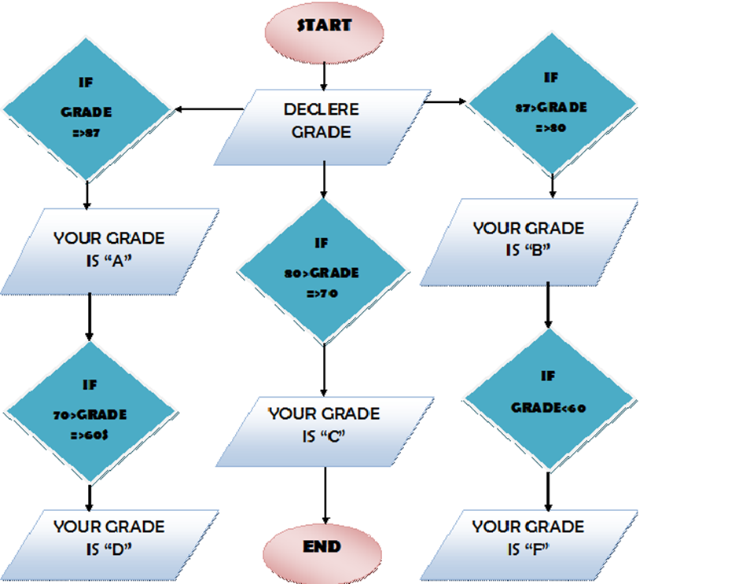
FLOWCHART

Slide 9



